Slide 1

Scientific Machine Learning for Wave-Structure Interaction Modelling: Uncertainty Quantification, Predictable Zone, and Structural Responses
Jincheng Zhang, Rui Li, Xiaowei Zhao, Jierao Dai
University of Warwick
Siya Jin, Daming Wang, Martyn Hann, Deborah Greaves
University of Plymouth

Slide 2

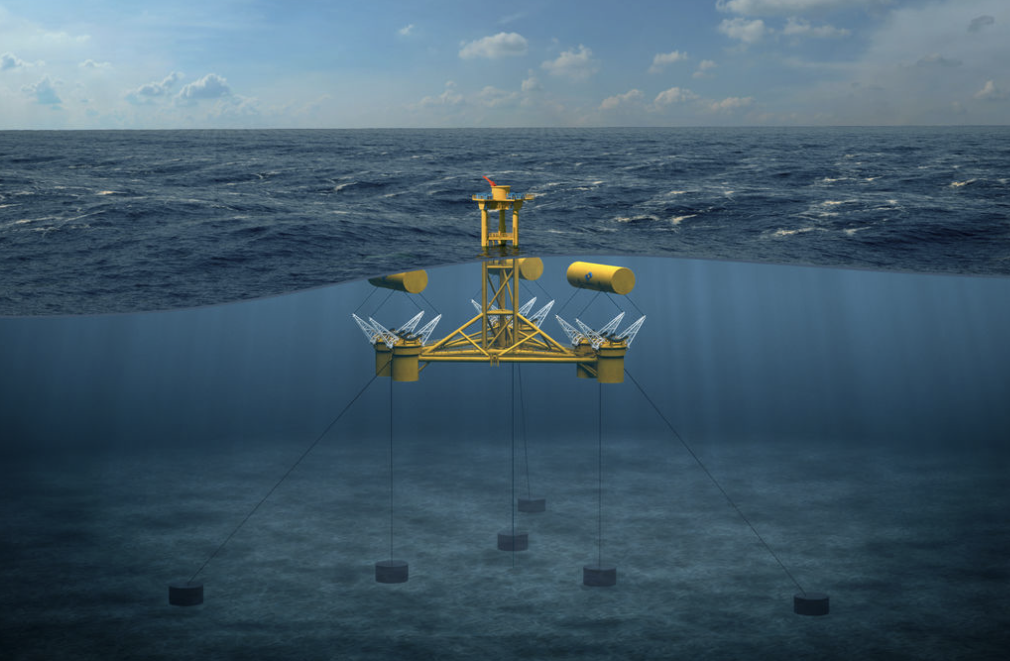
Motivation
Wave Forecasting
WEC Modeling
Optimal control of wave energy converters (WECs)
Power forecasting
Mitigation of the structural fatigue
Extreme event forecasting
The Great Wave off Kanagawa (by Hokusai)
MPS’ WaveSub device (Courtesy of Marine Power Systems)

Slide 3
Phase-resolved real-time ocean wave prediction
Linear wave theory
Real-time
Linear waves
Predictable zone determination
Higher order spectral (HOS) method
computationally expensive
nonlinear waves
Machine learning method
real-time
nonlinear waves
Overly conservative estimations of what can be predicted
Research objectives:
(1) A novel wave prediction method that can achieve real-time prediction of nonlinear waves with quantified uncertainty.
(2) A novel wave prediction method that can achieve real-time prediction of three-dimensional nonlinear waves

Slide 4
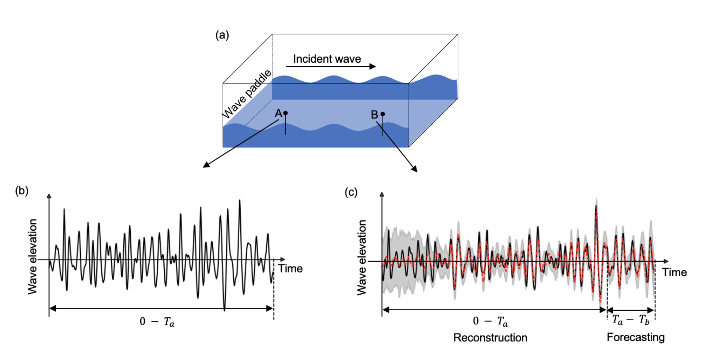
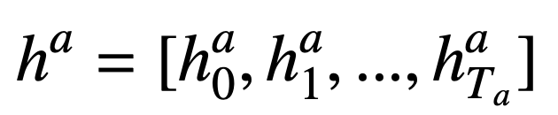
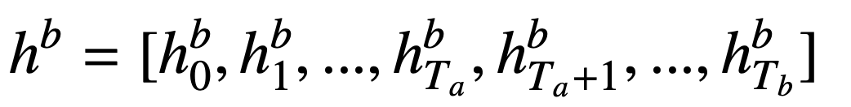
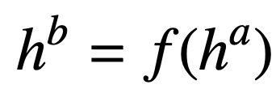
Problem formulation

Slide 5
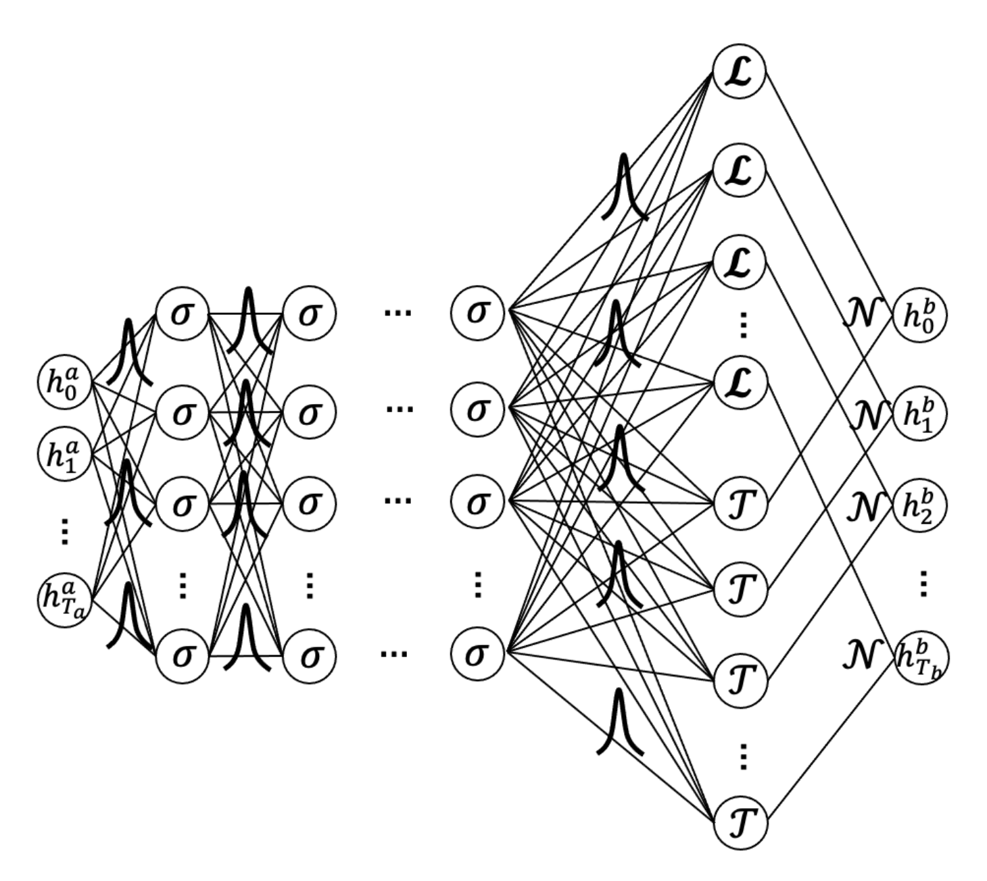
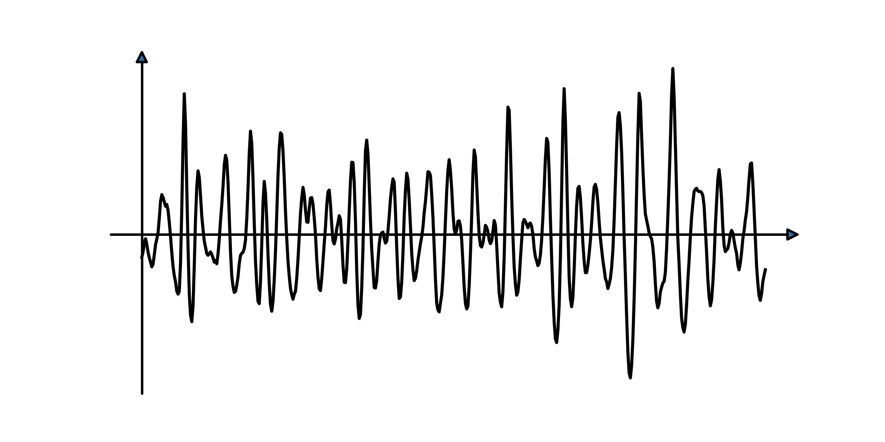
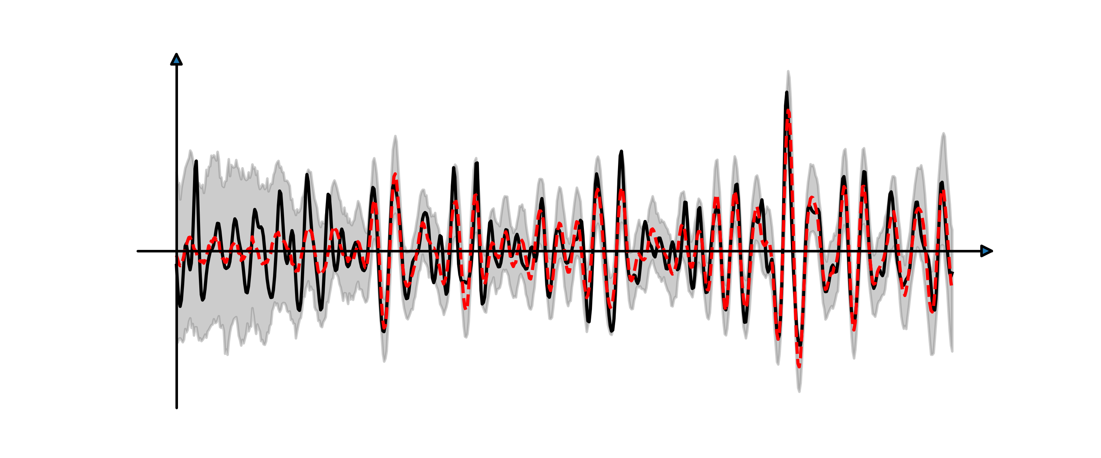
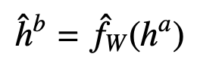
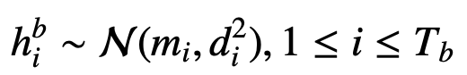
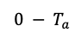
Wave forecasting with quantified uncertainty via Bayesian machine learning
Wave elevation
Wave elevation
$${0 − T}_{a}$$
Reconstruction
Forecasting
Aleatory uncertainty
Model uncertainty

Slide 6
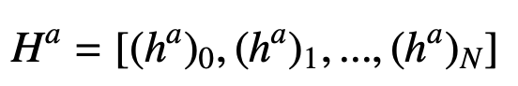
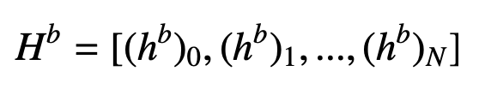
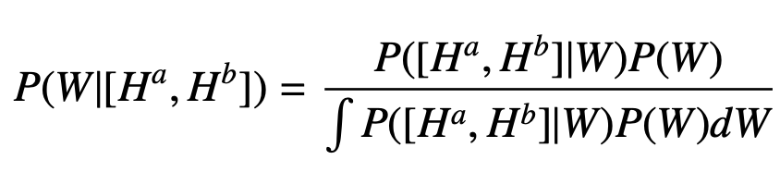
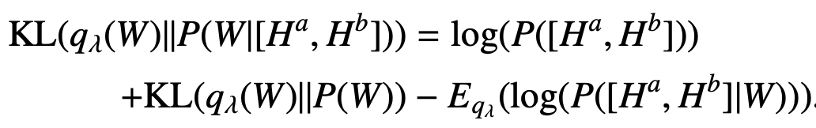
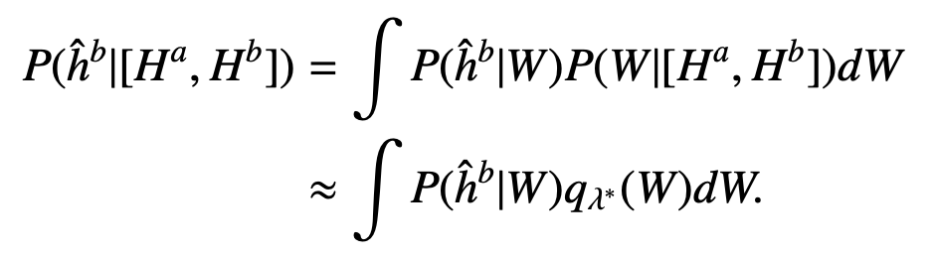
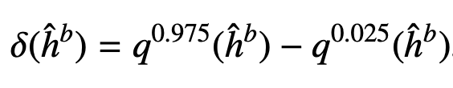
Bayesian machine learning approach
Training dataset
Training input:
Training target:
Model training
Bayes’ rule:
Variational inference:
Online prediction
Posterior distr. of the wave elevations:
Predictable zone determination
Uncertainty level:

Slide 7
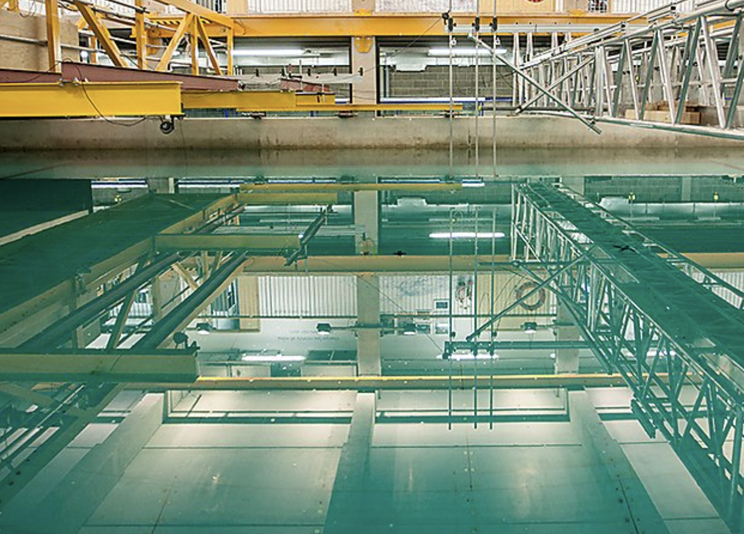
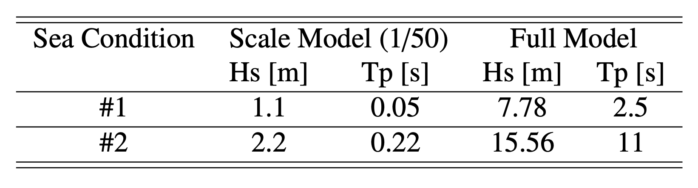
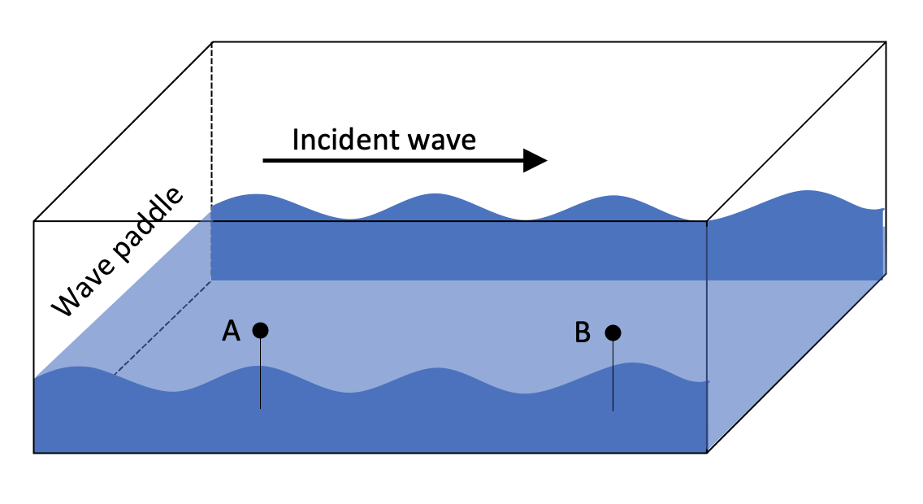
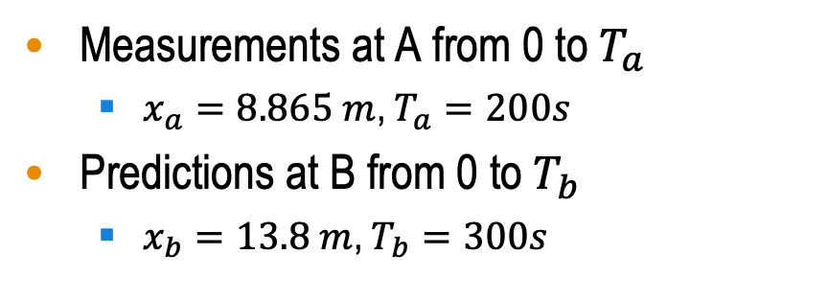
Wave tank experiments
Simulated sea conditions
For each sea condition
Peak enhancement factors γ = 1 & 3.3
Six different random seeds for wave generation
In total 24 simulated wave scenarios
Wave tank at COAST Laboratory at the University of Plymouth
Measurements at A from 0 to $T_{a}$
$x_{a}=8.865 m$, $T_{a}=200s$
Predictions at B from 0 to $T_{b}$
$x_{b}=13.8 m$, $T_{b}=300s$

Slide 8
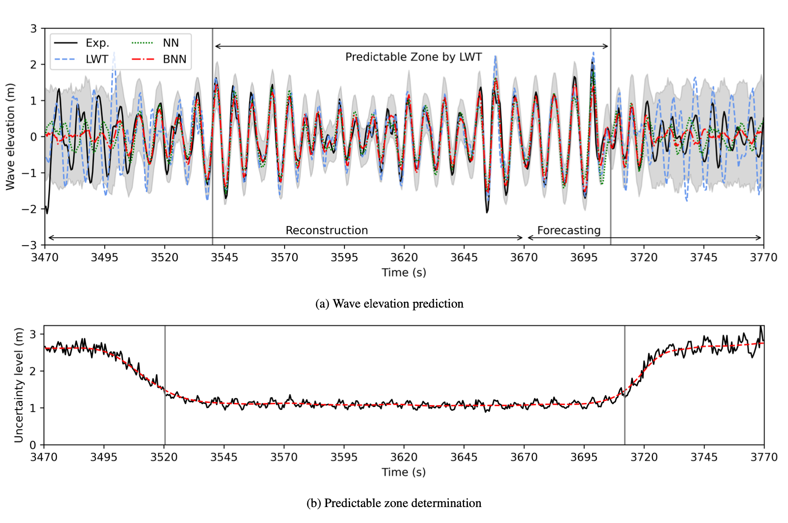
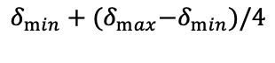
Results – both reconstruction and forecasting
Wave elevation prediction and predicable zone
Waves to be predicted has not arrived at the location A yet.
Waves at the location B have already passed the location A.
$$δ_{min}+{{(δ}_{max}−δ}_{min})/4$$

Slide 9
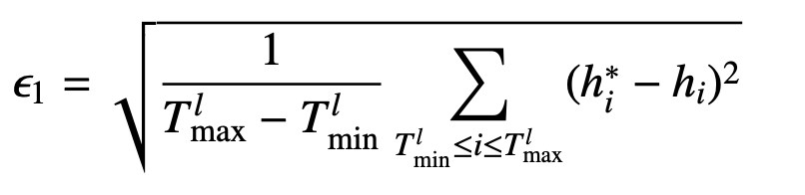
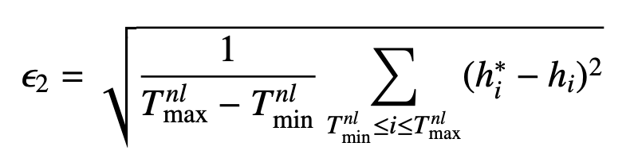
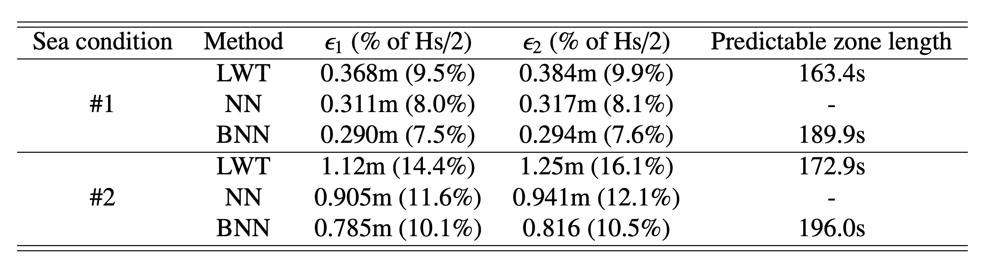
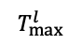
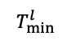
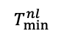
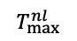
Results – both reconstruction and forecasting
Root mean square error
$$T_{min}^{nl}$$
$$T_{min}^{l}$$
$$T_{max}^{l}$$
$$T_{max}^{nl}$$

Slide 10
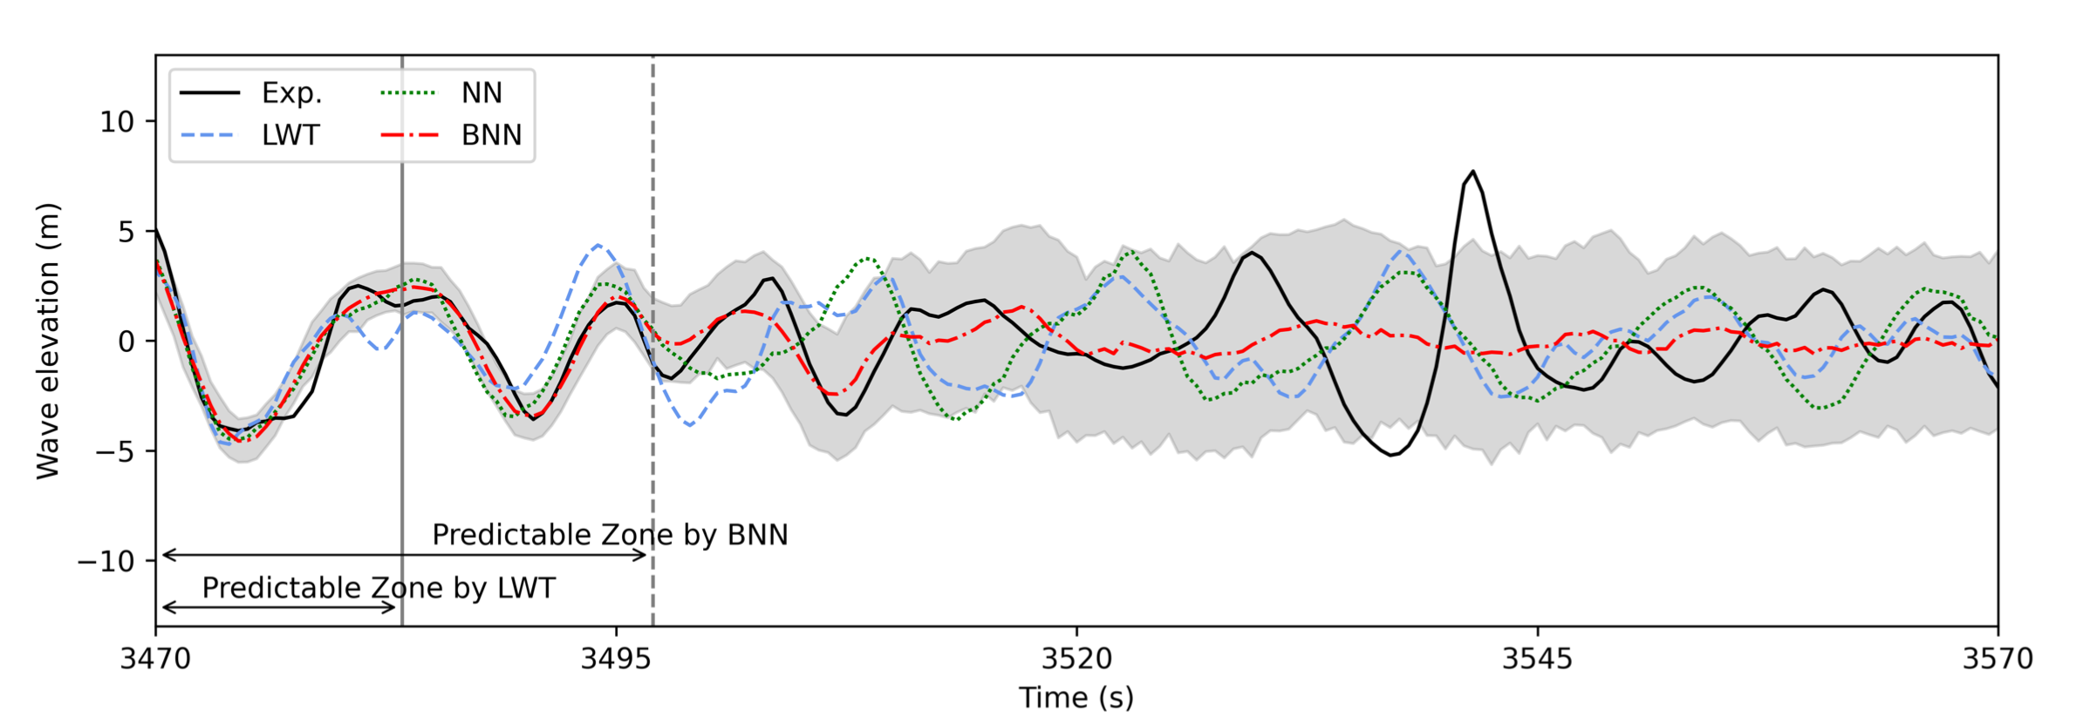
Results – the forecasting part
Wave elevation prediction and predicable zone
Waves to be predicted has not arrived at the location A yet.

Slide 11
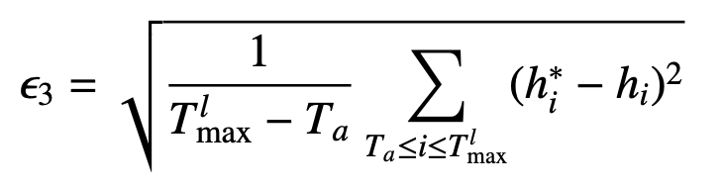
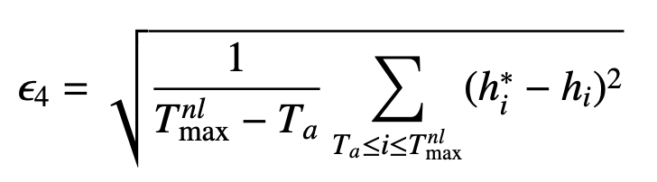
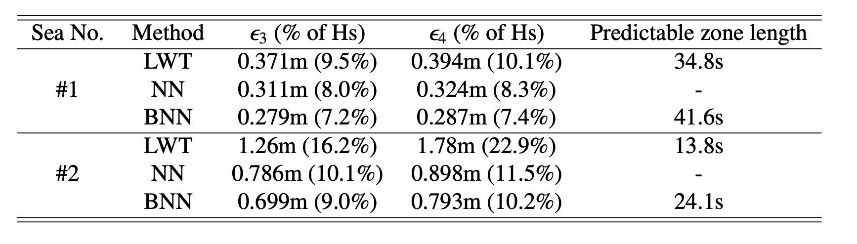
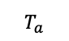
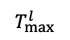

Results – the forecasting part
Root mean square error
$$T_{a}$$
$$T_{max}^{l}$$
$$T_{max}^{nl}$$

Slide 12
Conclusions
Phase-resolved wave prediction
Real-time prediction of nonlinear waves with quantified uncertainty
Predictable zone determination without assuming linear sea states
Bayesian machine learning approach
Neural networks: nonlinear problems
Bayesian framework: various forms of uncertainties (including both aleatory and model uncertainties)
Method evaluations
Prediction accuracy
Well-quantified prediction uncertainty
Outperform existing methods
Substantially larger credible forecasting horizon

Slide 13
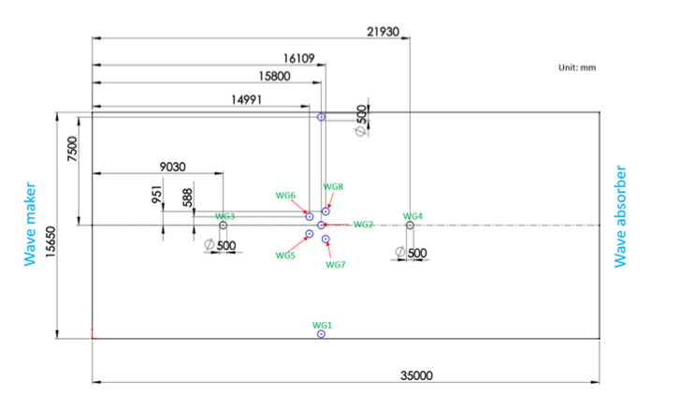
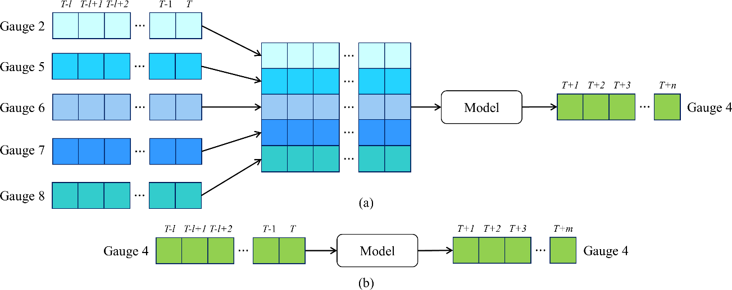
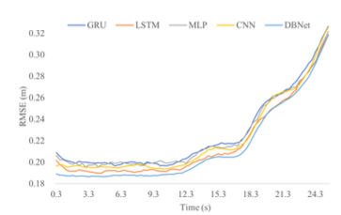
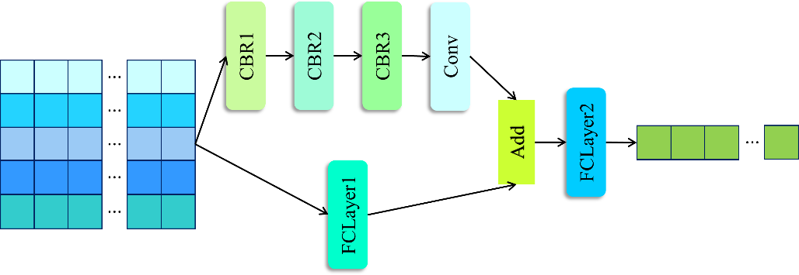
Extension to directional wave forecasting
Upstream gauge array (WG2, 5, 6, 7, 8)
Downstream gauge (WG4)

Slide 14
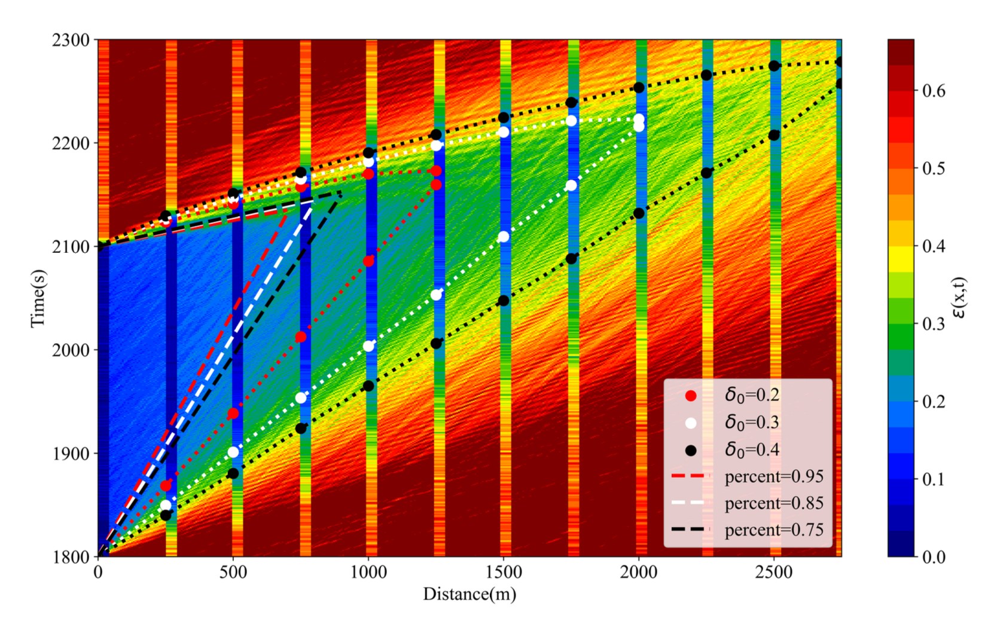
Spatiotemporal extension via numerical simulations
Prediction error of LWT (background contour) and VBNN (vertical strips) in the normal sea condition.

Slide 15
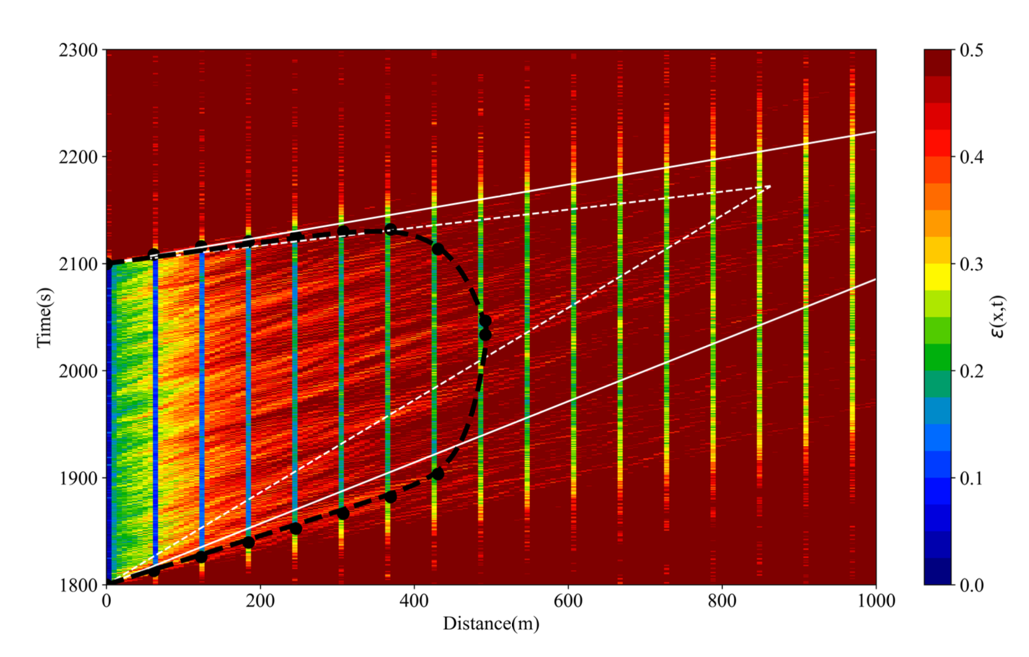
Spatiotemporal extension via numerical simulations
The prediction error from the LWT (in the background) and VBNN (in the front vertical strips) in severe sea condition.

Slide 16
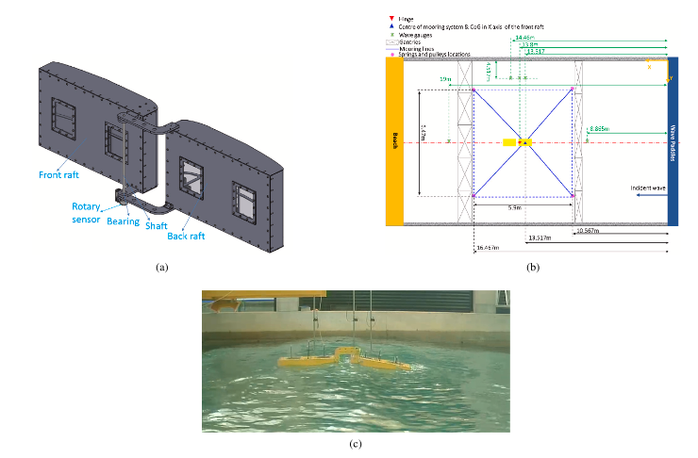
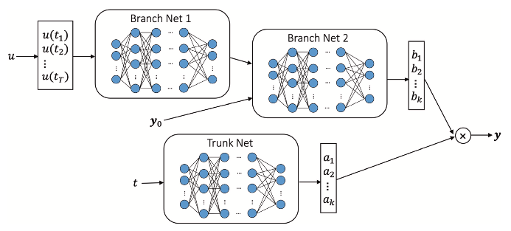
Modeling of WECs via deep operator learning
Research motivations:
(1) Design machine learning model to take advantage of the underlying data structure
(2) To develop the first data-based continuous-time WEC model

Slide 17
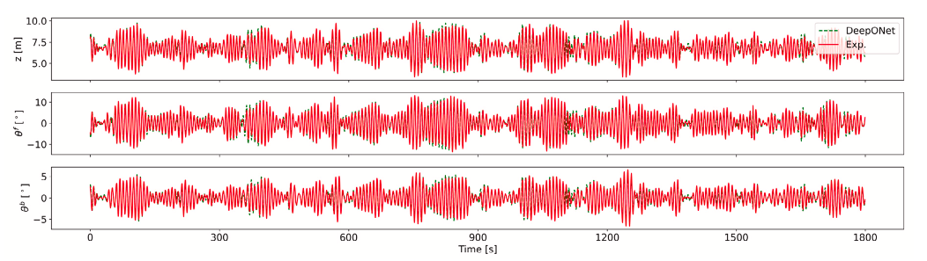
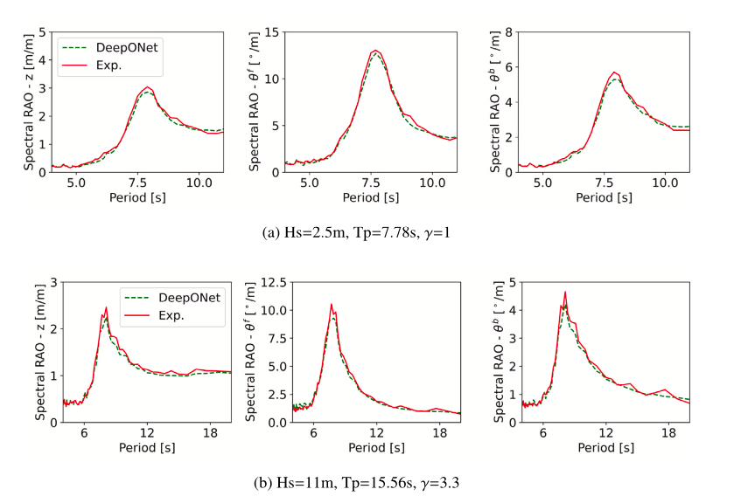
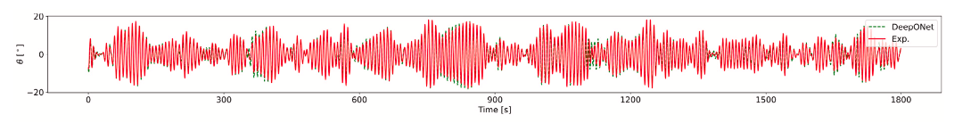
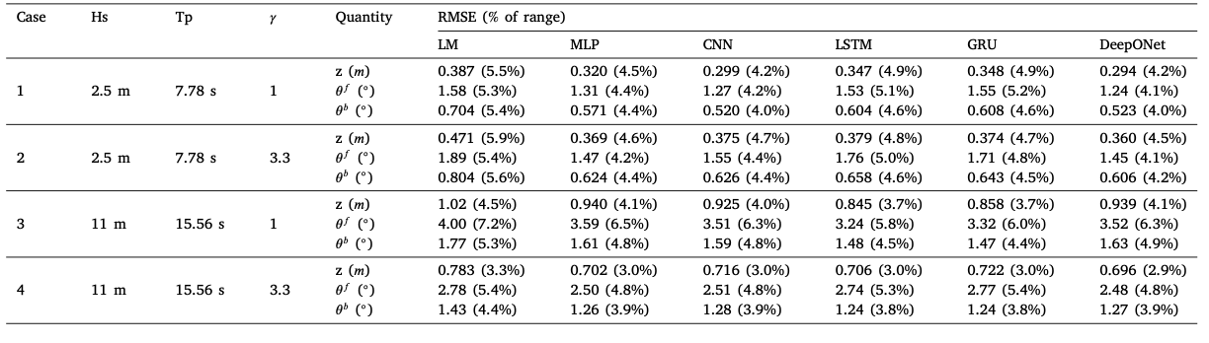
Predictions for WEC motions
The predictions by the developed model, including the spectral response amplitude operator (RAO) for the WEC’s vertical displacement, the front raft’s pitch angle, and the back raft’s pitch angle
The predictions by the developed model, including the WEC’s vertical displacement, the front raft’s pitch angle, the back raft’s pitch angle, and the hinge position

Slide 18
References
J. Zhang, X. Zhao, S. Jin, and D. Greaves, Phase-resolved real-time ocean wave prediction with quantified uncertainty based on variational Bayesian machine learning, Applied Energy 324 (2022) 119711.
R. Li, J. Zhang, X. Zhao, D. Wang, M. Hann, and D. Greaves, Phase-resolved real-time forecasting of three-dimensional ocean waves via machine learning and wave tank experiments, Applied Energy 348 (2023) 121529.
J. Dai, J. Zhang, and X. Zhao, Spatiotemporal nonlinear ocean wave prediction with uncertainty quantification and universal predictable zone determination, Journal paper draft (under review), 2025.
J. Zhang, X. Zhao, D. Greaves, and S. Jin, Modeling of a hinged-raft wave energy converter via deep operator learning and wave tank experiments, Applied Energy 341 (2023) 121072.

Slide 19
Thanks for your attention
Dr Jincheng Zhang and Prof Xiaowei Zhao
Intelligent Control and Smart Energy (ICSE) Research Group
School of Engineering
University of Warwick, United Kingdom

